Slide 1
Working with Young People Series
Kate Hills
Head of Safeguarding Ethics and Youth Development

Slide 2
Working with YP
Identify the topic
Identify the group
Identify the method of engagement
Set boundaries:
Work in group
Leave no one out
Don’t draw on each other
Use the Lundy model to ensure all areas are covered

Slide 3
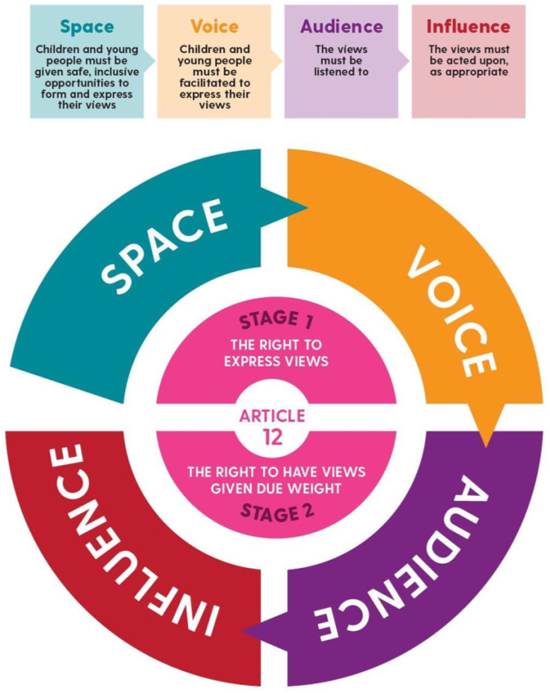
Updated Lundy model of Youth Participation
Ensure that YP’s views are taken seriously and acted upon, where appropriate

Slide 4
SPACE
Have YP’s views been actively sought?
Was there a safe space in which YP can express themselves freely?
Have steps been taken to ensure that all YP can take part?
VOICE
Have YP been given the information they need to form a view?
Do YP know that they do not have to take part?
Have YP been given a range of options as to how they might choose to express themselves?
AUDIENCE
Is there a process for communicating YP’s views?
Do YP know who their views are being communicated to?
Does that person/body have the power to make decisions?
INFLUENCE
Were YP’s views considered by those with power to effect change?
Are there procedures to ensure that YP’s views are taken seriously?
Have YP been given feedback explaining reasons decisions made?

Slide 5
Methods to use
Moving debate
Lifelines or timelines
Voting
Silent discussion
Suggestion box
Survey
Workshop
Feedback sheets

Slide 6
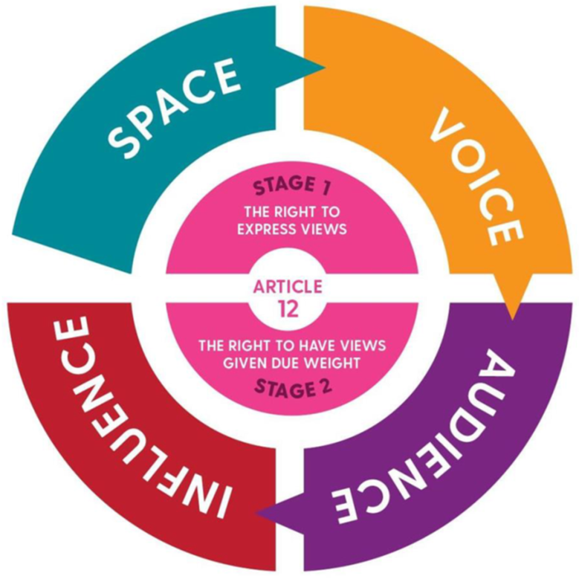
Using the model: Working with YP
Choose a group
Choose policy / topic / or ask for their ideas
Tell the group what it is about, why and where it is going!
Area | To do
Safe space | Choose a safe space: may be done at home/group/in club Ensure everyone has opportunity within group – their choice
Have a voice | Provide policy /topic or ask for their ideas for discussion Explain topic, including why looking for their views Be clear on what YP need to know about the topic to help them put their views; don’t tell them what to think! YP can choose how they want to give their views
Audience | Inform YP their views will be collected by CCO (or whoever is liaising with them) Views/ideas will go to relevant groups (depending on the topic) e.g. CCO, Coach, Club, Committee, NCO etc.
Influence | Explain how their views will be used and what change could be made by giving their views Feedback with decisions based on their views/ideas

Slide 7
Questions to help
Do you have someone to talk with?
What do you think are your challenges ahead?
How do you see yourself?
Reflective questions:
Where am I – reflect on current place/situation
What can I do better – re-evaluate what needs to be done
What will help me – review what there is
What is my new plan – revise ANY old plans
Write it down – record your thoughts and new plan
Helping YP to recognise their PRESENT self:
I am powerful. What I believe and how I respond changes my world and my thinking. I am free to listen to my emotions, mind, and body. I am growing in strength and resilience every day.

Slide 8
Suggestions
Suggested topics for working with young people:
Squad contract
Identifying and choosing captains
Team building with CCO & Coach collaboration
Choosing new kit
Recognising YP achievements/ Planning CYA
Information wanted/needed
Use of social media/ Online activities
Acceptable/not acceptable behaviour
Expectations for season
End of year social/ Choosing an outing
Inclusivity
Five ways of Well-Being/ Coping strategies

Slide 9
Working with YP
E.g. Squad contracts (codes of conduct)
Use group / survey / suggestion box / captains
Safe space | Choose a safe space to ask the group to put together a squad contract
Have a voice | Squad should decide: How the squad should behave as team Behaviour they expect of each other Behaviour that shouldn’t happen
Audience | CCO will collect their views: Report back to squad Squad agree final wording Squad will decide on where and how to be delivered
Influence | Inform coach Inform committee Inform parent/carers

Slide 10
Working with YP
Identifying role & choosing Captains
Use group / suggestion box for ideas
Safe space | Choose a safe space to to suggest the topic e.g. 4/5mins before session starts
Have a voice | Squad decide: What they want of a Captain Nominations – nominees present their plan? Election process?
Audience | CCO will collect their views: Set out Captain role with squad Nominees present election manifest! Election Report back to the coach
Influence | Inform coach Inform committee Inform parent/carers

Slide 11
Working with YP
CCO and Coach collaboration: Getting squads together/team building
Suggestion box for ideas/ use captains / squad meetings
Safe space | Choose a safe space to ask question e.g. 4/5mins before session starts
Have a voice | Ideas for doing something together e.g. outside pool Ideas for something in session e.g. fun session; takeover session; internal gala; visit from well-known swimmer etc
Audience | CCO collect their views; Present ideas back to squad – and get them to vote on suggestions Report back if any not feasible and why Report back to the coach to agree plan
Influence | Help arrange for it to happen!

Slide 12
Working with YP
Topic: Building a team
Workshop or Captains to run Q&A session
Safe space | Choose a safe space to gather the squad, or ask Captains to arrange
Have a voice | Split into groups; suggested questions: What type of situations help you by being part of a team? How can the club help support this? Suggest ways to bring a team together?
Audience | CCO to collate the responses Check back with the squad – to confirm understanding Bring suggestions to committee/coach to propose actions Respond to young people with outcomes
Influence | Inform coach Inform committee Inform parent/carers

Slide 13
Working with YP
Club collaboration: Choosing new kit
Suggestion box/meeting/captains /squad meetings /survey
Safe space | Choose a safe space to ask question e.g. 4/5mins before session starts
Have a voice | Set the boundaries – free choice or selection of options Costs involved What are the restrictions
Audience | Collect their views; Present to squads – maybe vote Present to committee
Influence | Showcase the new kit!

Slide 14
Working with YP
YP views: Recognising YP outside competitions
Suggestion box/meeting/captains /squad meetings /survey
Safe space | Choose a safe space to ask question e.g. 4/5mins before session starts
Have a voice | Set the basis for question: What would you like to be recognised for outside your achievements in competitions? How would you like to be recognised?
Audience | Collect their views; Present to squads – may need to vote on the themes Present to committee Present to NCO!
Influence | Review of the Club Youth Awards

Slide 15
Working with YP
Topic: Planning Club Youth Awards
Captains/Aquatic Leaders/Senior Squads
Safe space | Choose a safe space to discuss and get feedback e.g. meeting room or social space (e.g. breakfast/prior to session)
Have a voice | Explain the concept of Club Youth Awards – ask: What activities can YP do in the Club How often? Who should sign the achievement Group can come up with a guide for YP working towards their CYA
Audience | Collate responses; share with committee and coaches Get agreement for guide to be implemented in the club
Influence | Share the guidance and support the squad to work with the young er members in achieving the CYA

Slide 16
Working with YP
YP views: What information would YP like to see in the HUB
Suggestion box/meeting/captains /squad meetings /survey
Safe space | Choose a safe space to ask question e.g. 4/5mins before session starts
Have a voice | Set the basis by explaining (briefly!) about the HUB: What information would they find useful in: MIND BODY LIFE SKILLS Answer the survey:
Audience | Collect their views: Pass to NCO Add to map of information currently
Influence | Included in the HUB when launched

Slide 17
Working with YP
YP views: Use of Social Media in the Club
Workshop meetings/captains /squad meetings /survey
Safe space | Choose a safe space to ask question e.g. 4/5mins before session starts
Have a voice | What is good about social media in the Club? What would you like to see on the Club social media platforms? What are the dangers of social media in the Club?
Audience | Collect their views: Present to Committee – preferably by the athletes
Influence | Look at the way in which the Club uses social media platforms

Slide 18
Working with YP
YP views: Online activities and how people should behave
Workshop with CCO/captains
Safe space | Choose a safe space to ask question e.g. 4/5mins before session starts
Have a voice | Use age-appropriate resources from Educational Resources - UK Safer Internet Centre
Audience | Collate responses; share with committee and coaches – ensure reflected in squad agreements and codes for club including adults
Influence | Share documents/actions from workshops

Slide 19
Working with YP
YP views: Acceptable/not acceptable behaviour
Workshop meetings/captains /squad meetings /survey
Safe space | Choose a safe space to ask question e.g. 4/5mins before session starts
Have a voice | What is acceptable behaviour? What is not acceptable behaviour? How does the group deal with unacceptable behaviour? ‘What you walk by is what you accept’– what does this mean?
Audience | Collect their views and acceptable behaviour suggestions Discuss with coach/team managers/others working with the athletes
Influence | Create Club awareness and ethos with members

Slide 20
Working with YP
YP views: Expectations of the season (outside training!)
Workshop meetings/captains /squad meetings /survey
Safe space | Choose a safe space to ask question e.g. 4/5mins before session starts
Have a voice | What would they like to see happening in the club? What additional events would they like?
Audience | Collect their views and suggestions Discuss with coach/team managers/others working with the athletes
Influence | Ensure suggestions taken on board, and feedback to YP the possibilities (and if not accepted and why!)

Slide 21
Working with YP
YP views: End of year social event – inclusivity
Workshop/ captains /squad meetings /survey
Safe space | Choose a safe space to ask question e.g. few minutes before session starts or when all together at competition etc.
Have a voice | Ask all squads: what would you like to do? Consider different ages Consider funds available
Audience | Present ideas and suggestions to committee, coaches & others working with the athletes
Influence | Ensure the suggested activities are incorporated into what actually happens (if not explain why!)

Slide 22
Working with YP
Topic: Choosing a social outing (Christmas!)
Workshop or Captains to run Q&A session
Safe space | Choose a safe space to gather the squad, or ask Captains to arrange
Have a voice | Split into groups; provide relevant parameters choices e.g. any restriction on costs; age; timing etc
Audience | CCO/Captains collate the responses Check back with the squad for understanding CCO or Captain bring suggestions to committee Feedback to young people with outcomes
Influence | Inform committee Inform parent/carers

Slide 23
Working with YP
YP views: Team activity – inclusivity
Workshop meetings/captains /squad meetings /survey
Safe space | Choose a safe space to ask question e.g. 4/5mins before session starts
Have a voice | Thinking about whole squads: some will attend competitions & some not; what would the young people like to do?
Audience | Present ideas and suggestions to coaches, team managers & others working with the athletes
Influence | Set up activity

Slide 24
Working with YP
YP views: Engaging with Connect/Learn/Active/Notice/Give
Workshop meetings/captains /squad meetings /survey
Safe space | Choose a safe space to ask question e.g. 4/5mins before session starts
Have a voice | Think about the 5 ways to MH&WB – focus on week 7th – 11th November Discuss ideas as to how the club could engage in each area
Audience | Present ideas and suggestions to squads, coaches, team managers & others working with the athletes
Influence | Plan engagement week with young people and promote

Slide 25
Working with YP
Topic: Identifying how to cope with challenges
Workshop in person to provide support/guidance
Safe space | Choose a safe space to gather the squad, convenient time for them
Have a voice | Split into groups – own choosing; put questions: What situations do you find challenging in sport? How can the club help support you? What can you do to help yourself and others?
Audience | CCO to collate the responses Check back with the squad – to confirm understanding Bring suggestions to committee/coach to propose findings Respond to young people with outcomes
Influence | Inform coach Inform committee Inform parent/carers

